Slide 1
Unit-V- Graph

Slide 2
Graph
Graphs- Basic Concepts, Storage representation, Adjacency matrix, adjacency list adjacency multi list, inverse adjacency list
Traversals-depth first and breadth first
Minimum spanning Tree: Greedy algorithms for computing minimum spanning tree- Prims and Kruskal Algorithms
Dikjtra's Single source shortest path
All pairs shortest paths- Flyod-Warshall Algorithm Topological ordering
Case Study: Data structure used in Web graph and Google map

Slide 3
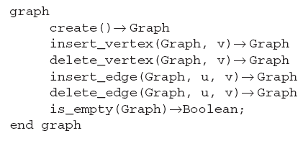
GRAPH ABSTRACT DATA TYPE
A graph is a set of vertices and edges {V, E} and can be declared as follows:

Slide 4
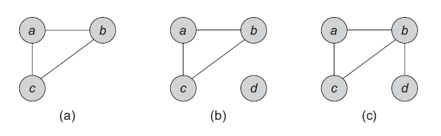
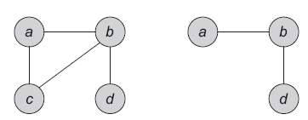
Create
Insert Vertex
Delete Vertex

Slide 5
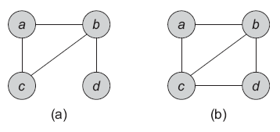
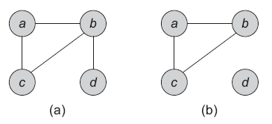
Insert Edge
Delete Edge
Is_empty

Slide 6
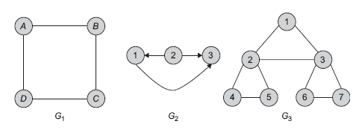
Representation of GraphS
Adjacency Matrix (sequential representation)

Slide 7
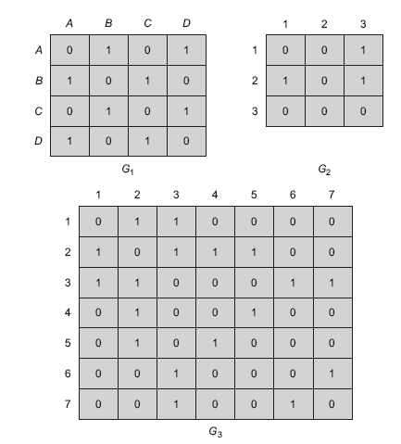

Slide 8
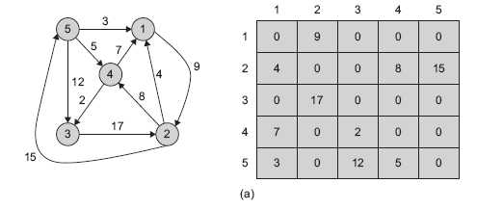
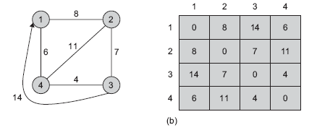

Slide 9
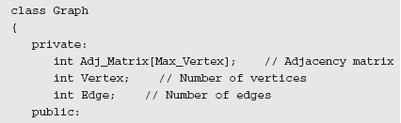
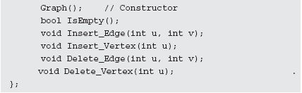
class defined for graph implementation using an adjacency matrix with some basic functions.

Slide 10
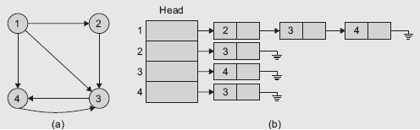
2. Adjacency List

Slide 11
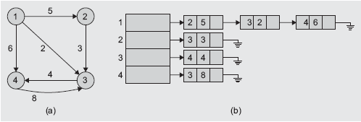

Slide 12

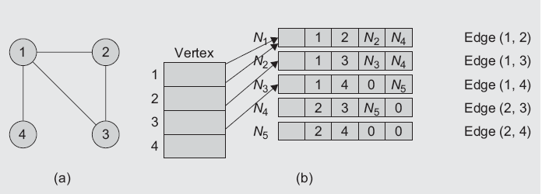
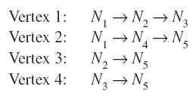
3. Adjacency Multilist

Slide 13
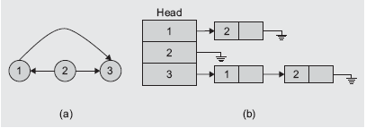
4. Inverse Adjacency List

Slide 14
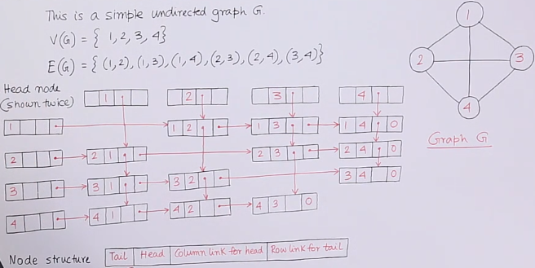
4. Orthogonal List Representation

Slide 15
Comparison of Sequential and Linked Representations
1. Adjacency matrix representation always requires an n x n matrix with n vertices, regardless of the number of edges. It needs more memory asymptotically. If the graph is sparse, many of the entries are null. However, since it provides direct access, it is suitable for many applications.
2. Linked representation (adjacency list) of a graph has an advantage of space complexity when a graph is sparse but does not provide direct access. The probable disadvantage of adjacency list is that it does not allow direct access, and hence, we cannot quickly determine whether an edge between any two vertices is incident or not.
3. Though the list representation is asymptotically as efficient as a matrix representation, the simplicity of the matrix is preferred when the graph is small. In addition, for a weighted graph, an additional field is needed in the graph node, whereas for matrix representation, the same matrix can be used. Considering all these aspects, the matrix representation of a graph is more powerful than all the other forms.

Slide 16
GRAPH traversal
Depth-first Search
Breadth First Search

Slide 17
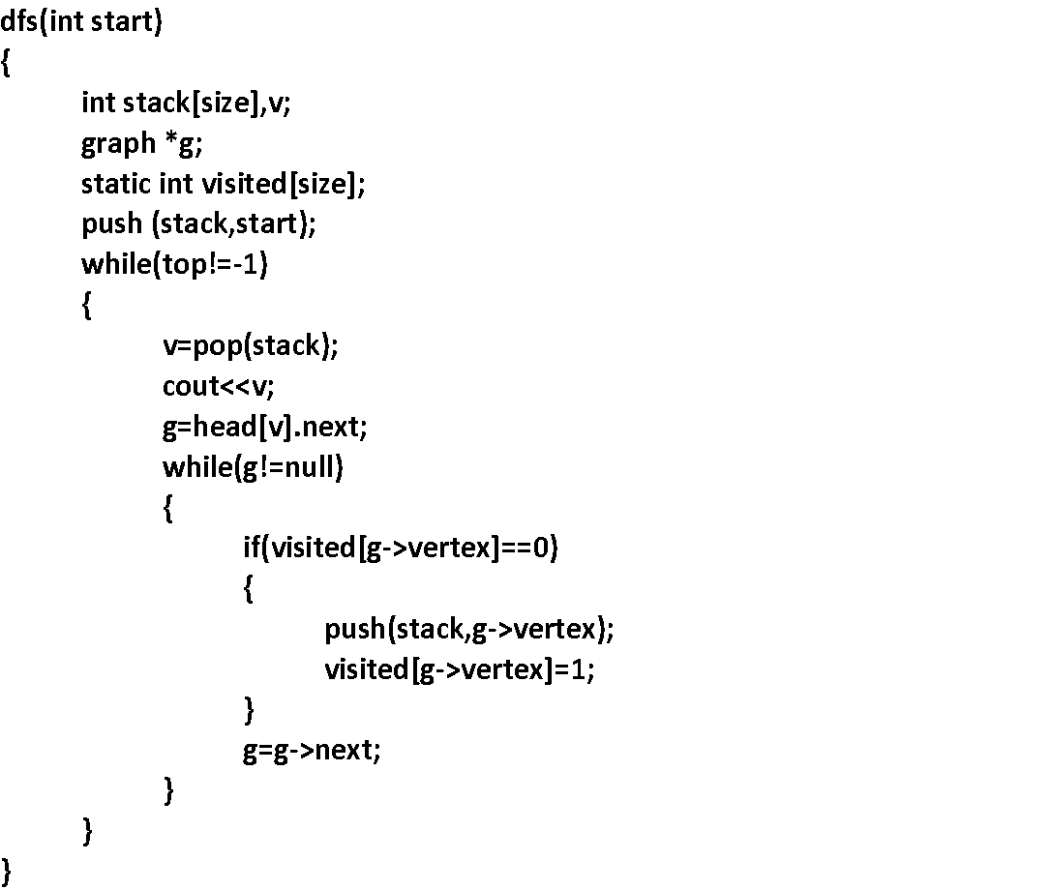

Slide 18
bfs(int start)
{
int queue[size],v;
graph *g;
static int visited[size];
add (queue,start);
visited [start]=1;
while(front!=rear)
{
v=delq(queue);
cout<<v;
g=head[v].next;
while(g!=null)
{
if(visited[g->vertex]==0)
{
add(queue,g->vertex);
visited[g->vertex]=1;
}
g=g->next;
}
}
}

Slide 19
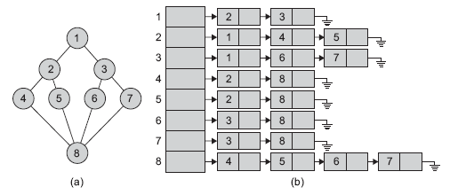

Slide 20
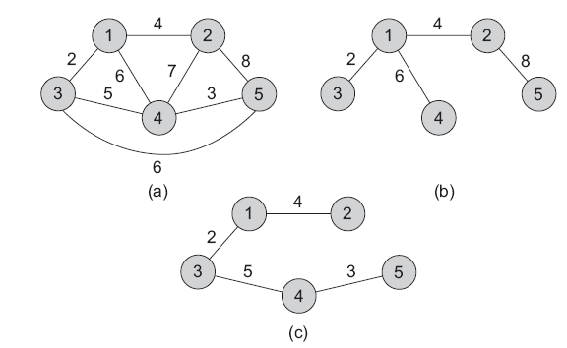
Spanning tree
A tree is a connected graph with no cycles. A spanning tree is a sub-graph of G that has all vertices of G and is a tree. A minimum spanning tree of a weighted graph G is the spanning tree of G whose edges sum to minimum weight

Slide 21
Methods used to compute the minimum spanning tree of a graph
Prim’s algorithm
2. Kruskal’s algorithm

Slide 22
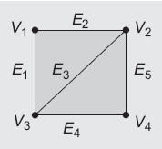
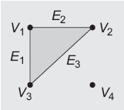
Connected Components
Sample graph G1 with
one connected component
Graph G2 with
two connected components

Slide 23
Prim’s Algorithm
A=ⱷ
For each v ϵ V
key[v] = ∞
parent[v] = null
Key[r] = 0
Q = V
While Q!=ⱷ
U = min(Q) by key value
Q = Q-u
If parent (u) !=null
A=A U (u, parent(u))
For each v ϵ Adj(u)
if v ϵ Q and w(u,v) < key[v]
parent [v] = u
key [v] = w
Return A

Slide 24
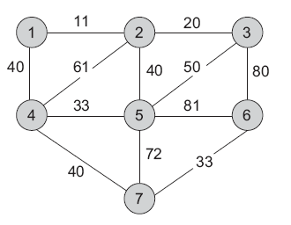
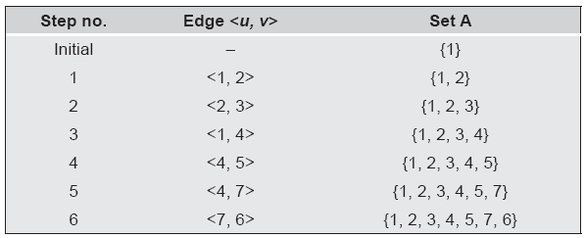

Slide 25
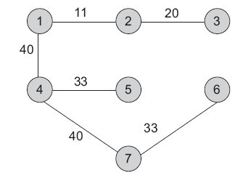
Minimum spanning tree

Slide 26
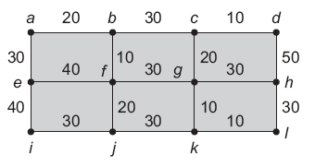

Slide 27
Kruskal’s Algorithm
A=ⱷ
For each v ϵ V
make-disjoint-set (v)
Sort E by weight incresingly
For each (v1,v2) ϵ E
if find (v1) != find (v2)
A = A U { (v1,v2)}
Union (v1,v2)
Return A

Slide 28
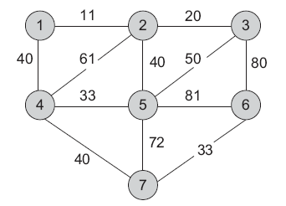
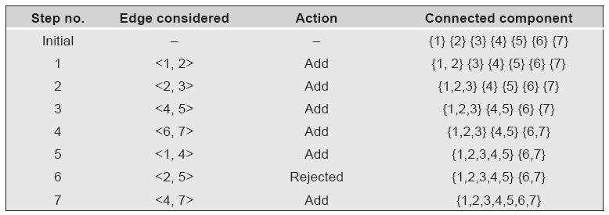

Slide 29
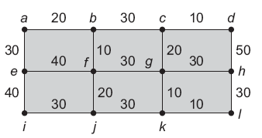
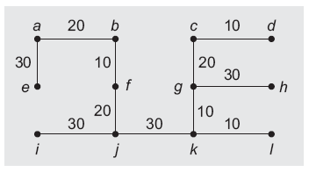

Slide 30
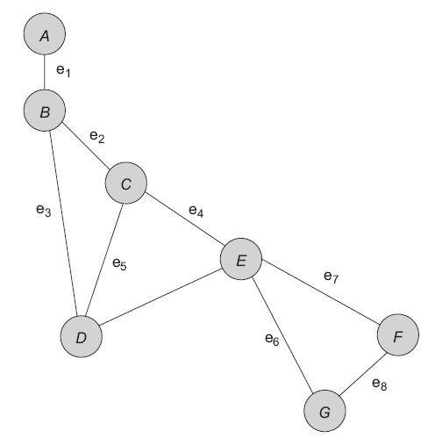
Biconnected Components

Slide 31
Disjoint Set Operations
Find : This is a membership check of the element. It determines the set in which a particular element is located and is also useful for determining whether two elements are in the same set or not.
Union This operation combines or merges two sets into a single set.
These two operations are supported by a disjoint-set data structure. Hence, it is also called as a union–find data structure or merge–find set.

Slide 32
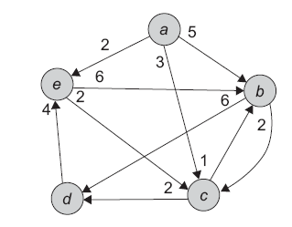
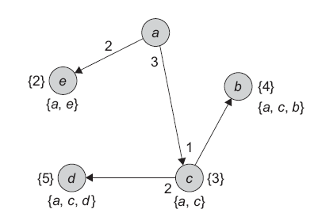
SHORTEST path algorithm

Slide 33
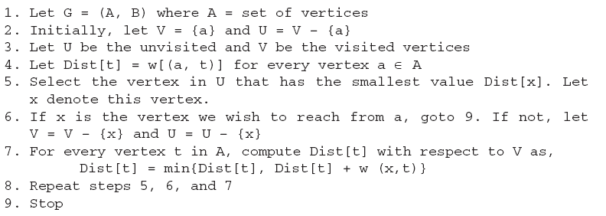

Slide 34
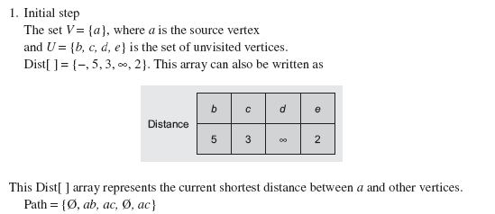
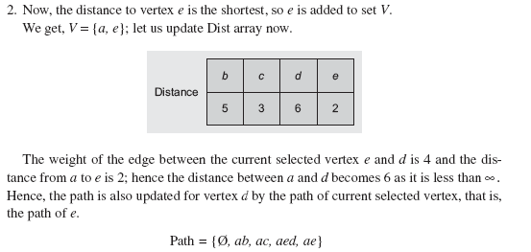

Slide 35
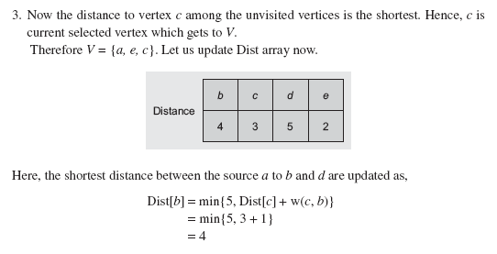

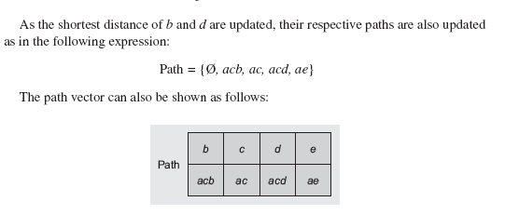

Slide 36
